Slide 1
Qualifying Exam
Asir Saadat
Supervised by
Dr. Bartosz Krawczyk

Slide 2
When to Say ‘I Don’t Know’: Abstention-Aware Continual Learning for Visual Question Answering

Slide 3
So many jargons!
When to Say ‘I Don’t Know’: Abstention-Aware Continual Learning for Visual Question Answering

Slide 4
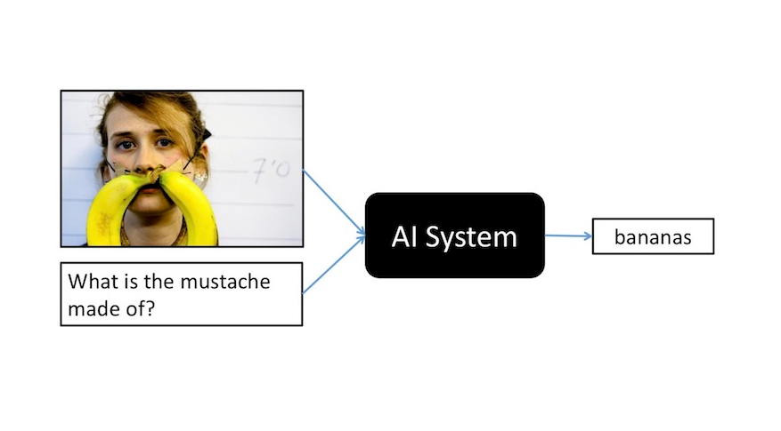
Visual Question Answer: Fusion of Vision and Language
VQA is a multimodal task that requires a model to answer a natural-language question about an image.
VQA: Visual Question Answering (Aishwarya Agrawal et al), ICCV 2015

Slide 5
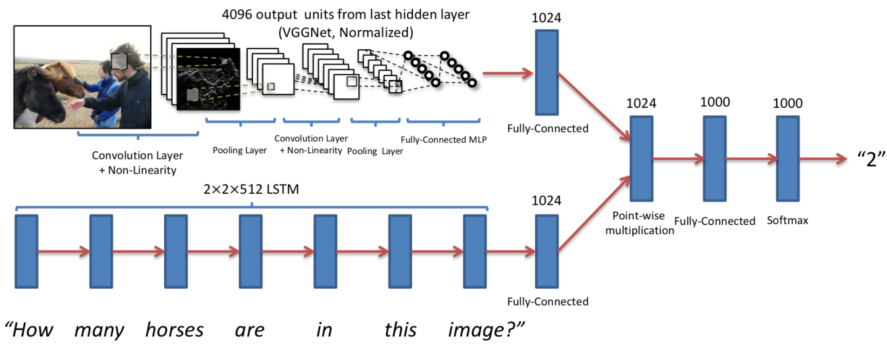
How does a VQA model work
The image is encoded using a VGGNet CNN, producing 4096-dimensional visual features.
The question is processed through an LSTM, capturing sequential word information.
A point-wise multiplication fuses visual and textual features for reasoning.
The fused vector passes through fully connected + softmax layers to predict the answer (“2”).
VQA: Visual Question Answering (Aishwarya Agrawal et al), ICCV 2015

Slide 6
Models

Slide 7
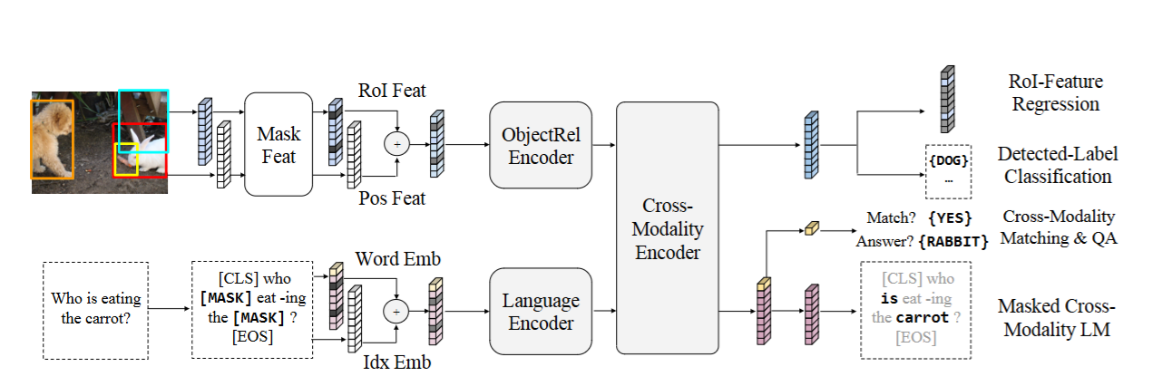
LXMERT
A transformer-based VQA model
The visual branch extracts region-of-interest (RoI) features using an object detector.
The language branch encodes the question text using a transformer.
A Cross-Modality Encoder fuses vision and text features through multi-head attention.
LXMERT: Learning Cross-Modality Encoder Representations from Transformers (Hao Tan et al), EMNLP 2019

Slide 8
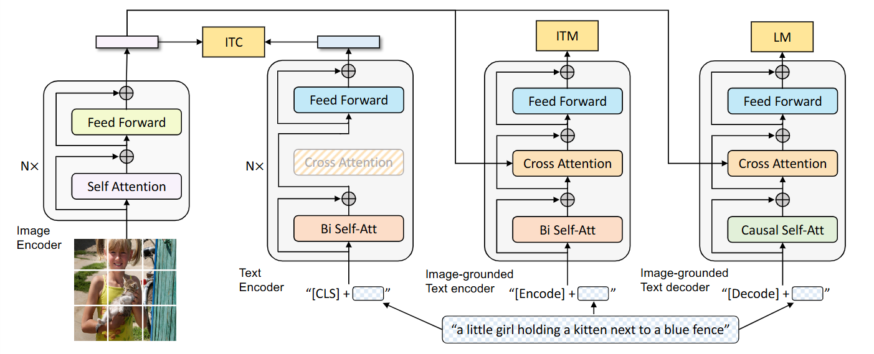
BLIP
(1) ITC – Image-Text Contrastive: aligns global image and text representations.
(2) ITM – Image-Text Matching: checks if an image and caption truly correspond.
(3) LM – Language Modeling: generates image-grounded captions.
BLIP jointly learns image–text alignment, matching, and caption generation through ITC, ITM, and LM objectives for unified vision–language understanding
BLIP: Bootstrapping Language-Image Pre-training for Unified Vision-Language Understanding and Generation (Junnan Li et al), PMLR 2022

Slide 9
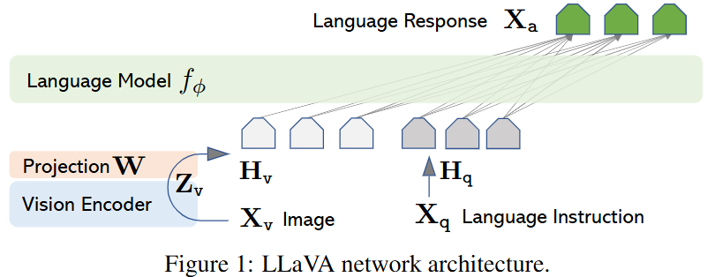
LLaVA
-LLaVA connects a CLIP-based vision encoder with a LLM through a learned projection layer.
-The vision encoder converts images into feature embeddings​, which are projected into the LLM’s token space.
-The language model receives both the image features and text instructions to generate natural language responses.
Visual Instruction Tuning (Haotian Liu et al), NeurIPS 2023

Slide 10
Dataset

Slide 11
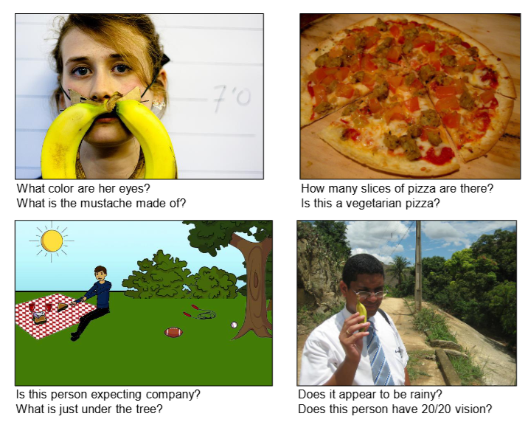
VQA v1
- Introduced in 2015, VQA v1 pairs real and abstract images with open-ended natural language questions.
-Contains 204K images (from MS-COCO and synthetic scenes) and 760K questions with 10 human answers per question.
VQA: Visual Question Answering (Aishwarya Agrawal et al), ICCV 2015

Slide 12
But what if models are presented with unanswerable questions?

Slide 13
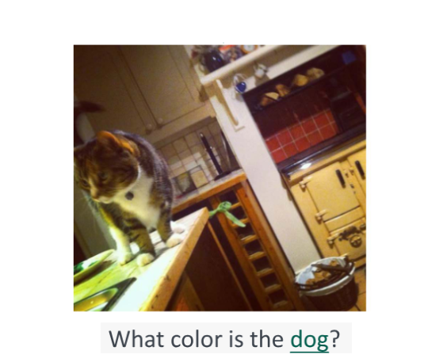
Clearly we can see that there are no dogs in the image but the models might still be presented with something that has no answer.
UNK-VQA: A Dataset and a Probe Into the Abstention Ability of Multi-Modal Large Models (Yangyang Guo et al), IEEE Transactions on Pattern Analysis and Machine Intelligence

Slide 14
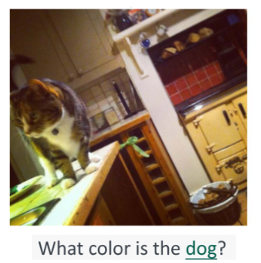
The color of the dog is brown
Large Language Model
The models do not know how to abstain from unanswerable dataset because they were never taught how to do so!
UNK-VQA: A Dataset and a Probe Into the Abstention Ability of Multi-Modal Large Models (Yangyang Guo et al), IEEE Transactions on Pattern Analysis and Machine Intelligence

Slide 15
What is the solution?
We need datasets of unanswerable question answering and train the models

Slide 16
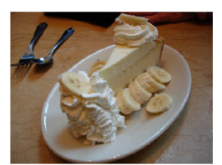

Unanswerable Question
The answer cannot be inferred because the required object, attribute, or relation is absent from the image

Slide 17

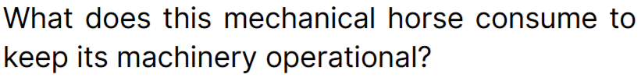
Unanswerable Question
Even if related objects exist, the information may be ambiguous or incomplete.

Slide 18
What are the existing datasets?

Slide 19
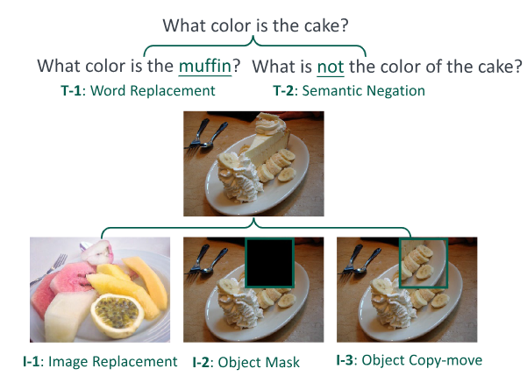
UNK-VQA
Word Replacement (T-1): swap key nouns in the question (e.g., “bridge” → “tunnel”).
Semantic Negation (T-2): add or remove negation words (“is” → “is not”).
Image Replacement (I-1): replace the image with a visually similar one lacking the queried object.
Object Masking (I-2): mask the main object related to the question.
Object Copy-Move (I-3): copy another region over the relevant object
UNK-VQA: A Dataset and a Probe Into the Abstention Ability of Multi-Modal Large Models (Yangyang Guo et al), IEEE Transactions on Pattern Analysis and Machine Intelligence

Slide 20
Okay, we already have several datasets for unanswerable or irrelevant questions...
But every time a new dataset appears, do we really need to retrain the entire model from scratch?
Can’t we make the model learn continuously and adapting to new types of unanswerable cases without forgetting the old ones?”

Slide 21
Continual Learning says hi!

Slide 22
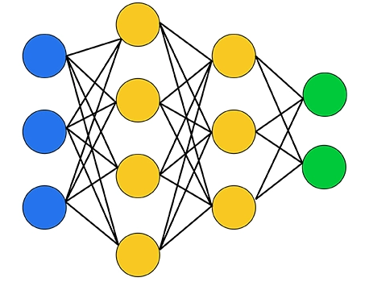




Catastrophic forgetting
Task 1
Task 2
Learns to classify mail spamming
Learns to classify toxic social media post
After task 2
Fails to classify mail spamming again

Slide 23
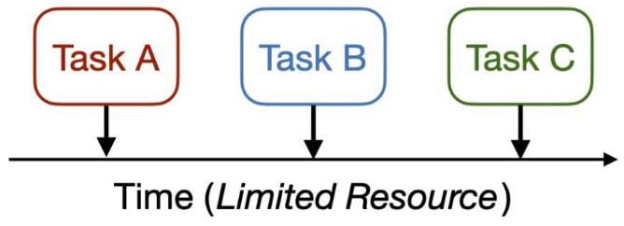
-In Continual Learning, a model learns tasks sequentially over time, just like humans.
-Each new task arrives one at a time, under limited resources (no access to all past data).
-The goal: learn new knowledge (Task B, C) without forgetting what was learned before (Task A).
A Comprehensive Survey of Continual Learning: Theory, Method and Application (Liyuan Wang et al), IEEE Transactions on Pattern Analysis and Machine Intelligence

Slide 24
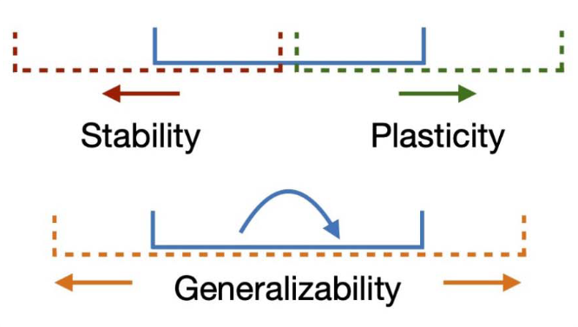
Stability–Plasticity Dilemma
Stability → Preserve what’s already learned (avoid forgetting).
Plasticity → Adapt quickly to new information or tasks.
In Continual Learning, we need both — but too much of one harms the other.
High stability → model can’t learn new tasks (rigid).
High plasticity → model forgets old tasks (catastrophic forgetting).
A Comprehensive Survey of Continual Learning: Theory, Method and Application (Liyuan Wang et al), IEEE Transactions on Pattern Analysis and Machine Intelligence

Slide 25
Continual Learning in VQA

Slide 26
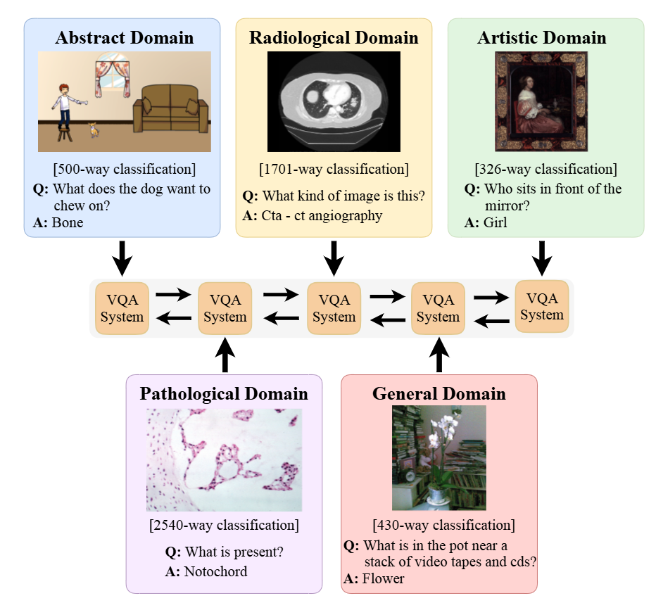
CL-Cross VQA
-Introduces CL-CrossVQA, the first benchmark for cross-domain continual learning in VQA, where a model learns to answer questions from multiple, very different domains.
-Tries to understand how multimodal models forget when shifting domains and how different CL strategies mitigate forgetting.
CL-Cross VQA: A Continual Learning Benchmark for Cross-Domain Visual Question Answering (Xi Zhang et al), WACV2025

Slide 27
But… training models for unanswerable questions in a continual learning setting has never been done before!
What happens when we combine these two ideas?
Unanswerable Question Answering
Continual Learning

Slide 28
Research Motivation
Static training doesn’t scale: Current abstention models must be retrained from scratch for every dataset. That’s inefficient and causes forgetting of previously learned abstention behaviors.
Need to balance learning and forgetting: Models should retain old abstention reasoning while adapting to new unanswerable patterns.
Trustworthy AI: As tasks evolve, being able to detect when not to answer ensures robustness and reliability.
4. Goal: Build VQA systems that learn to abstain continually.

Slide 29
My Research

Slide 30
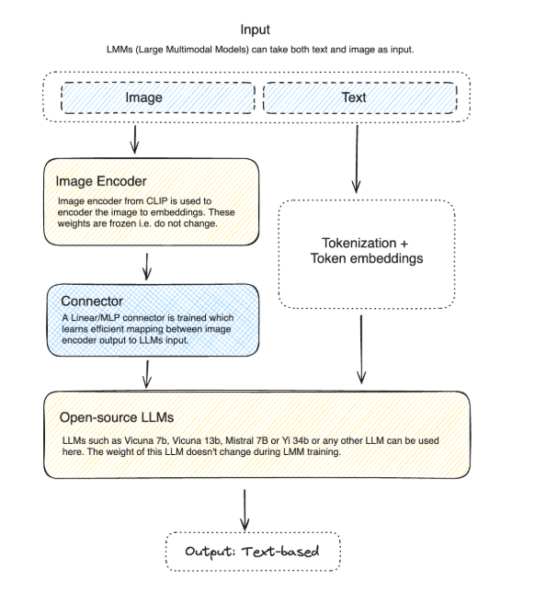
LLaVA architecture
-We take the LLaVA model first as our base model where we will be applying both continual and abstention methods on it and train on datasets.

Slide 31
Continual Learning Methods
Applying these continual learning methods to LLaVA base model.
Zero Shot-> Each dataset will be given to the model without any prior training.
Sequential Process -> Sequentially train the model with different datasets.
Experience Replay -> Stores a small memory buffer of samples from previous tasks and replays them during new training.
Dark Experience Replay -> Adds knowledge distillation loss between old and new model outputs to preserve old behavior while replaying samples
Dark Experience Replay Plus Plus -> Extension of DER that combines cross-entropy loss (for current tasks) + distillation loss (for old tasks) during replay
Elastic Weight Consolidation -> Penalizes changes to important parameters from previous tasks using the Fisher information matrix.
Memory Aware Synapses -> Similar to EWC, but measures parameter importance based on gradient sensitivity to the output function.

Slide 32
Abstention Method
At this points, we have a LLaVA base model, all the datasets that we will training on and lastly, the continual learning methods. Lastly, we may need implement an “Abstention Aware Mechanism” inside of LLaVA.
The main goal is, sending a message to the LLaVA so the models knows the question should be avoided answering. I want to introduce a module called “Image Question Relevancy” and everything else stays same.
LLM
Question
Tokenization
Output
Image Question Relevancy
Image
Image Encoder
Connector

Slide 33
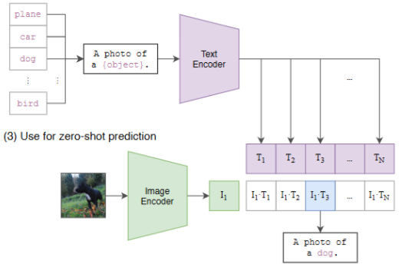
Image-Question Relevancy Module
So we want a layer where it learns to send the LLM if the image and question have any relationship or not. Thus, we will be using CLIP model for our case.
Example of CLIP model where it tries to get the most relevant image-question pair. With this idea, we can also get a relevancy score using the text and image encoder for question and image.
Learning Transferable Visual Models From Natural Language Supervision (Alec Radford et al), PMLR

Slide 34
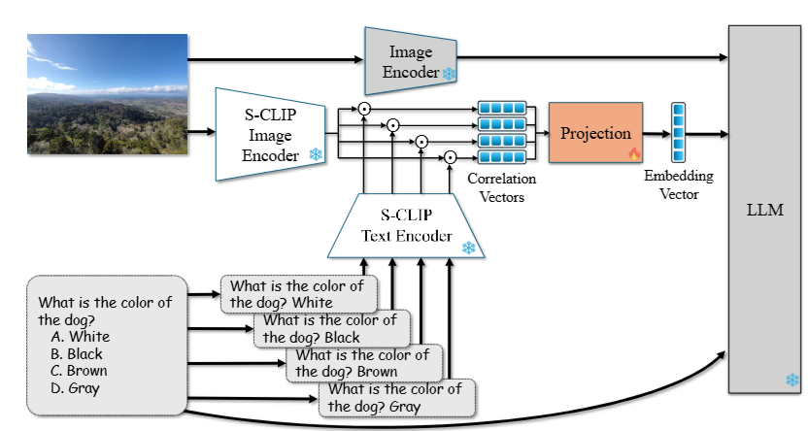
Image-Question Relevancy Module
Inspired by a model called CLIP-UP where they check if answers with question is relevant or not. We also create a similar module only for “image+question”.
CLIP-UP: CLIP-Based Unanswerable Problem Detection for Visual Question Answering (Ben Vardi et al)

Slide 35

Image-Question Relevancy Module
There will be a learnable projection layer between getting the similarity score and passing through LLM.
LLM
Image - Question Similarity using CLIP encoders.
Projection Layer

Slide 36
My Benchmarks

Slide 37
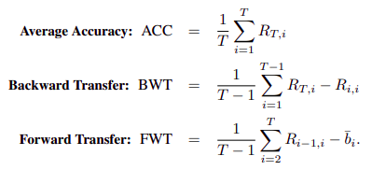
Metrics for CL
Average Accuracy - Measures the overall final performance after learning all tasks sequentially.
Forward Transfer - Measures how much learning earlier tasks helps the model learn future tasks faster or better.
Backward Transfer - Measures how learning new tasks affects performance on previous tasks

Slide 38
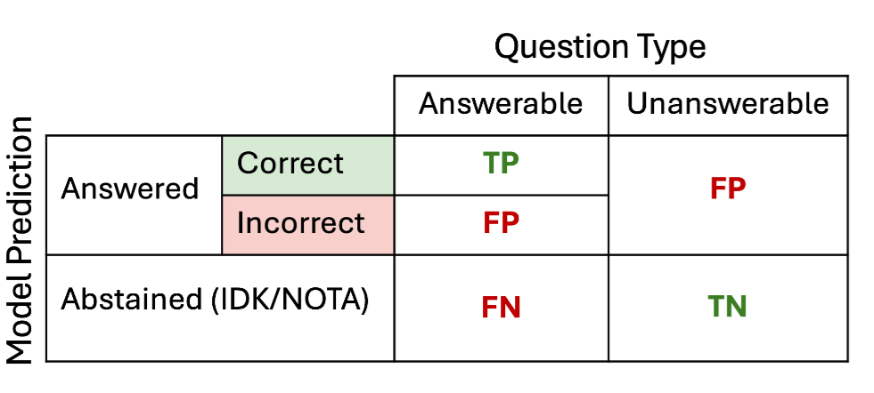
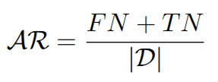
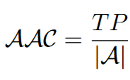
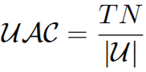
Metrics for Unanswerable Questions
For a paper, this confusion Matrix and metrics were used for evaluating models.
TP - Answered the answerable
FP - Incorrectly answered the answerable.
FN - Abstain the answerable
TN - Correctly abstaining the unanswerable,
Abstention Rate,
Answerable Accuracy,
Unanswerable Accuracy,
Do LLMs Know When to NOT Answer? Investigating Abstention Abilities of Large Language Models (Madhusudhan et al)

Slide 39
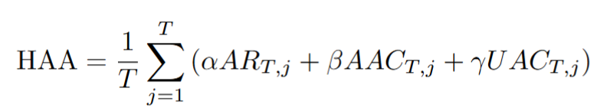
My Proposed Metrics
If we want to check how the model has abstains and performs as well, we take all the metrics into account. For this, we can write our metrics as -
Hallucination Aware Accuracy, where it takes abstention rate, answerable accuracy, unanswerable accuracy into account.
The same can be done for backward transfer and forward transfer
Do LLMs Know When to NOT Answer? Investigating Abstention Abilities of Large Language Models (Madhusudhan et al)

Slide 40
Future Works

Slide 41
Timeline
Current
December
March
Gathered the codebase for LLaVA and writing python scripts
Develop a system for image-question similarity score
Compare all the systems with our benchmark
Implement CL based methods into baseline model
Implement abstention aware system into best CL based method
Come up with the best CL based abstention aware VQA system
November - December
January - February
April

Slide 42
Fin.

Slide 43
Appendix.

Slide 44
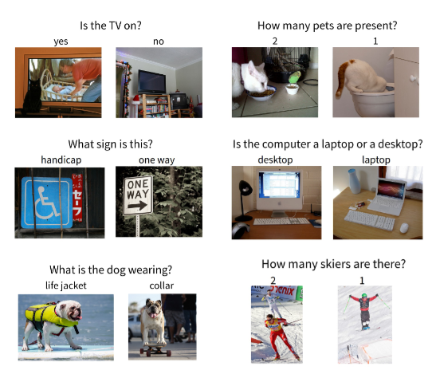
VQA v2
“Specifically, we balance the popular VQA dataset by collecting complementary images such that
every question in our balanced dataset is associated with
not just a single image, but rather a pair of similar images that result in two different answers to the question” - Authors
Making the V in VQA Matter: Elevating the Role of Image Understanding in Visual Question Answering
(Goyal et al), CVPR 2017

Slide 45
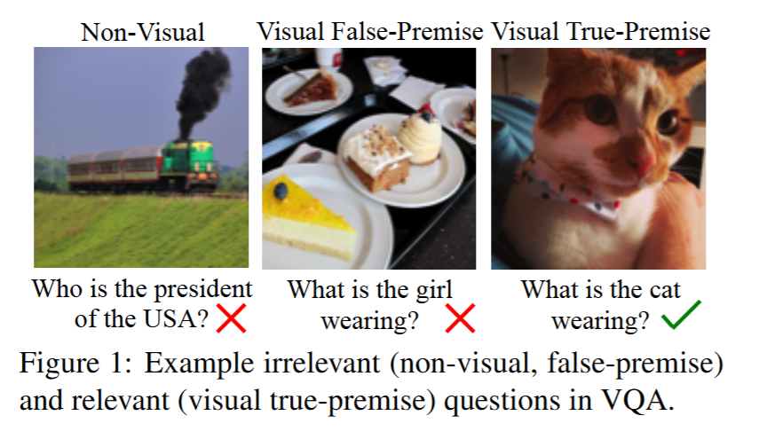
VNQ and VTFQ
- VNQ - Designed to classify whether a question requires looking at an image or can be answered from general knowledge.
- VTFQ - Focuses only on visual questions, and relevancy with the image.
Question Relevance in VQA: Identifying Non-Visual And False-Premise Questions (Arijit Ray et al), EMNLP 2016

Slide 46
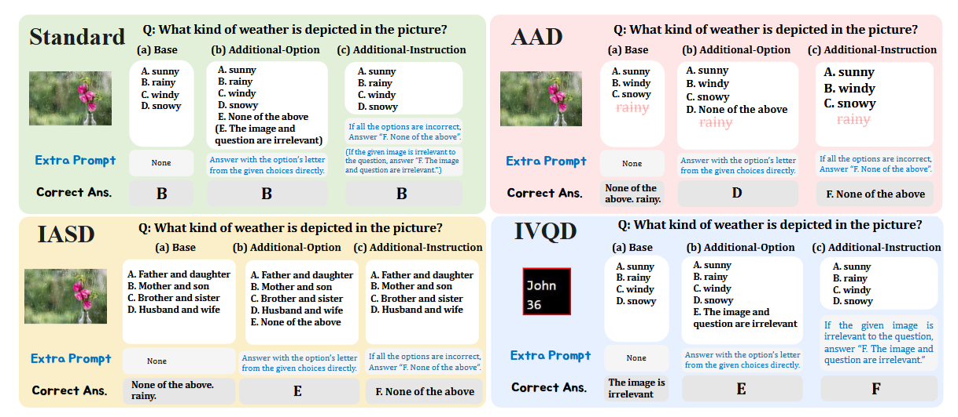
UPD
AAD - The correct answer does not exist in the given image.
IASD - The answer options themselves are unrelated to the question.
IVQD - The image and question are entirely mismatched (no shared context).
Unsolvable Problem Detection for Vision Language Models (Atsuyuki Miyai et al), ICLR 2024 Workshop

Slide 47
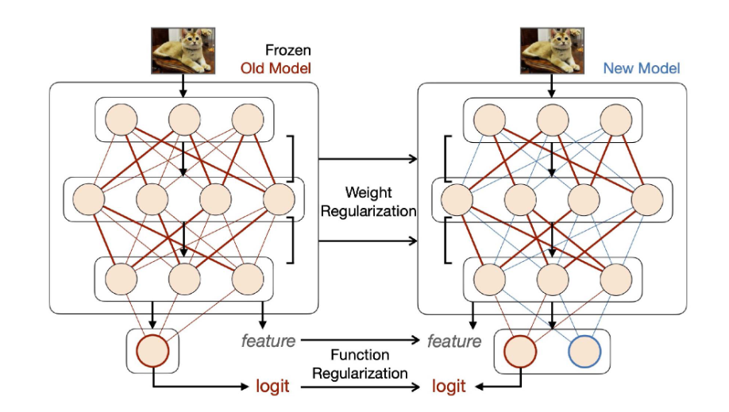
Regularization Based Approach
Weight Regularization:
Penalizes large changes to parameters that were important for previous tasks. The model learns new tasks but keeps old important weights close to their old values.
Function Regularization:
Instead of focusing on weights, it regularizes the output logits or features. The new model’s predictions are encouraged to stay close to the old model’s for previous tasks.
A Comprehensive Survey of Continual Learning: Theory, Method and Application (Liyuan Wang et al), IEEE Transactions on Pattern Analysis and Machine Intelligence

Slide 48
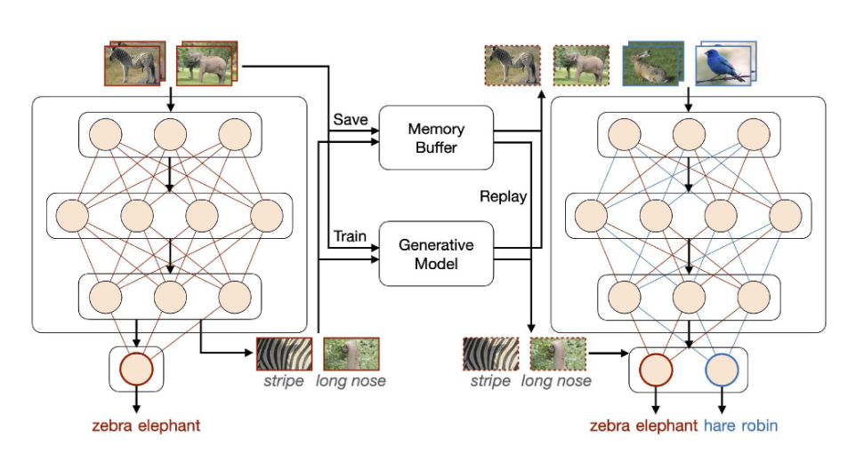
Replay-based approach
Experience Replay:
Keep a small buffer of real samples from previous tasks. When learning a new task, mix current data with a few samples from this buffer.
Generative Replay:
Instead of storing real data, train a generator (like a GAN or VAE) to recreate old samples. When learning new tasks, generate pseudo-samples from the old distribution.
A Comprehensive Survey of Continual Learning: Theory, Method and Application (Liyuan Wang et al), IEEE Transactions on Pattern Analysis and Machine Intelligence

Slide 49
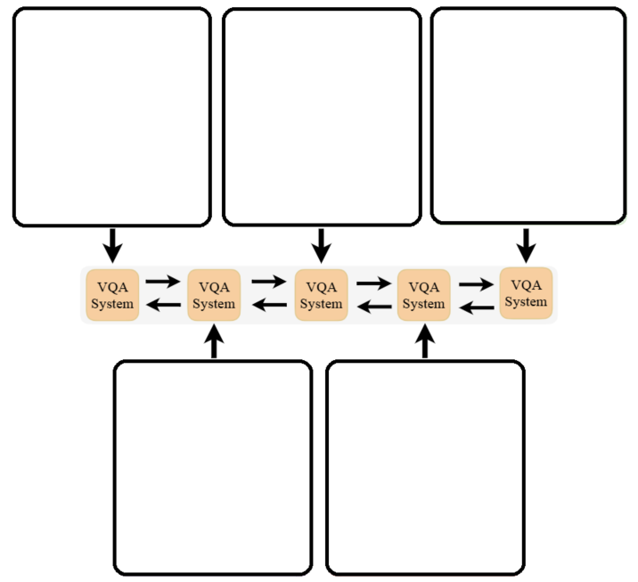
Datasets
QRPE
UNK VQA 1
UNK VQA 2
These are the datasets that we will be working on.
QRPE -> Each image–question pair is labeled as relevant or irrelevant.
UNK VQA 1 -> Contains questions for word replacement and image replacement
UNK VQA 2 -> Contains questions for object mask and object copy move
HaloQuest -> Includes counterfactual or synthetically altered images/questions.
UPD -> Categorizes failures by missing info, contradiction, or commonsense gaps.
HaloQuest
UPD

